Slide 1
Text Classification Using Graph Convolutional Neural Networks
Berk Sudan, Guneykan Ozgul, Onur Kilicoglu

Slide 2
INTRODUCTION
An essential intermediate step for text classification is text representation. Traditional methods represent text with hand-crafted features, such as sparse lexical features (e.g., bag-of-words and n-grams).
Recently, deep learning models have been widely used to learn text representations, including convolutional neural networks (CNN) (Kim 2014) and recurrent neural networks (RNN) such as long short-term memory (LSTM) (Hochreiter and Schmidhuber 1997).

Slide 3
As CNN and RNN prioritize locality and sequentiality (Battaglia et al. 2018), these deep learning models can capture semantic and syntactic information in local consecutive word sequences well, but may ignore global word co-occurrence in a corpus which carries non-consecutive and long-distance semantics (Peng et al. 2018).
Graph neural networks have been effective at tasks thought to have rich relational structure and can preserve global structure information of a graph in graph embeddings.

Slide 4
MODEL
Liang Yao, Chengsheng Mao, Yuan Luo from Northwestern University proposes a GCN model¶ to learn word and document embeddings simultaneously to overcome this problem.
The edge between two word nodes is built by word co-occurrence information and the edge between a word node and document node is built using word frequency and word’s document frequency, hence text classification problem becomes a node classification problem.
¶ https://arxiv.org/pdf/1809.05679.pdf

Slide 5
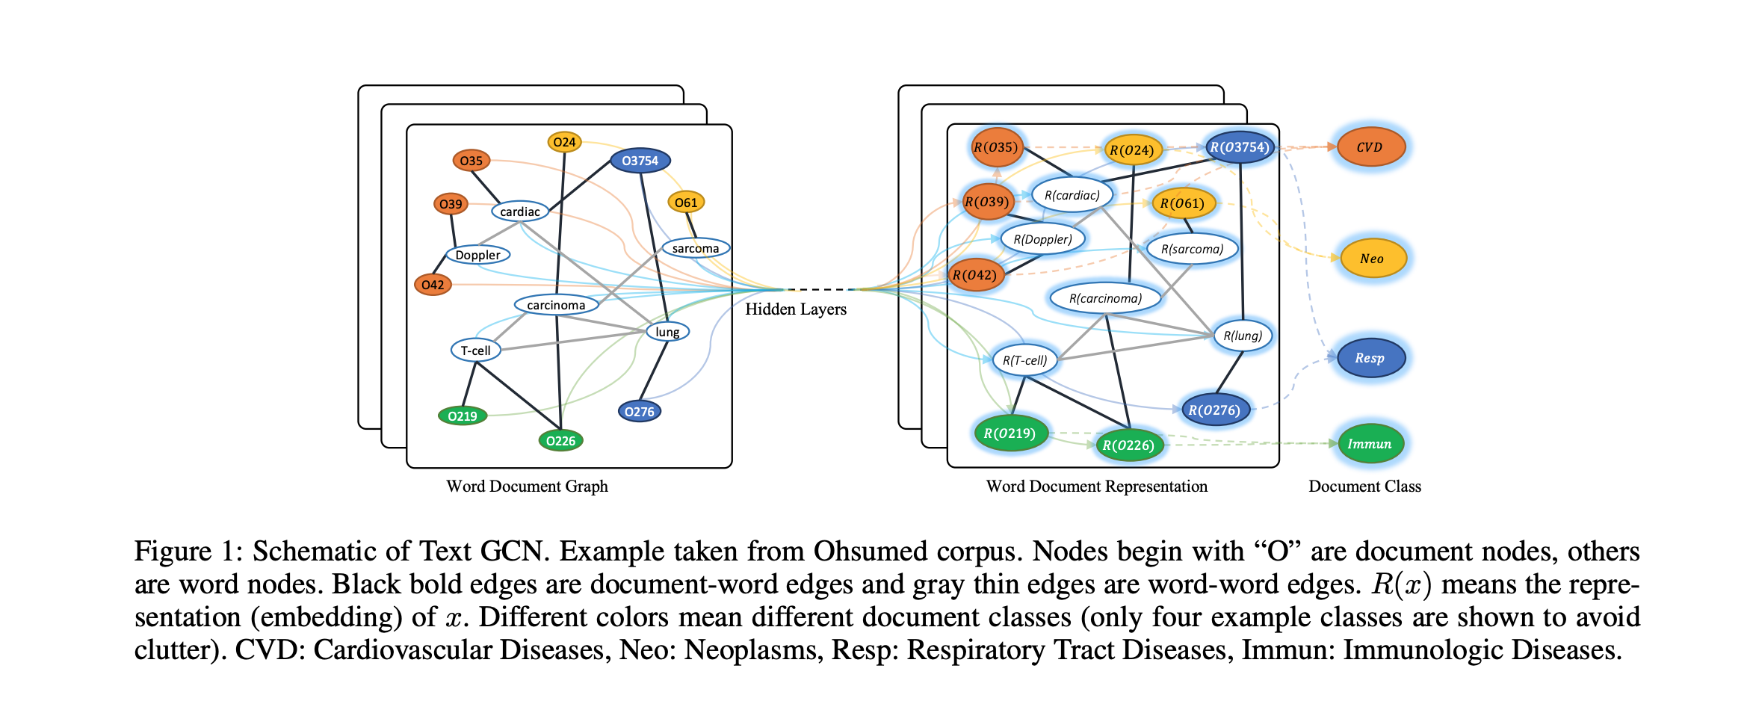

Slide 6
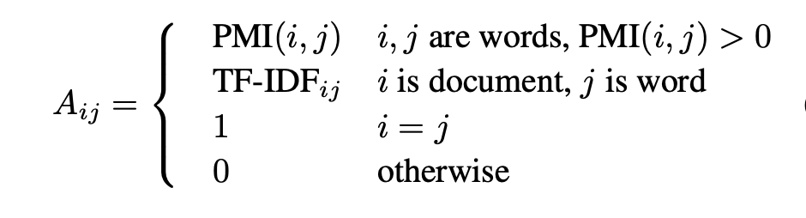
A large and heterogeneous text graph which contains word nodes and document nodes so that global word co-occurrence can be explicitly modeled and graph convolution can be easily adapted, then fed into a simple two layer GCN as in (Kipf and Welling 2017).

Slide 7
A two-layer GCN can allow message passing among nodes that are at maximum two steps away. Thus although there is no direct document-document edges in the graph, the two-layer GCN allows the information exchange between pairs of documents.
The second layer node (word/document) embeddings have the same size as the labels set and are fed into a softmax classifier.

Slide 8
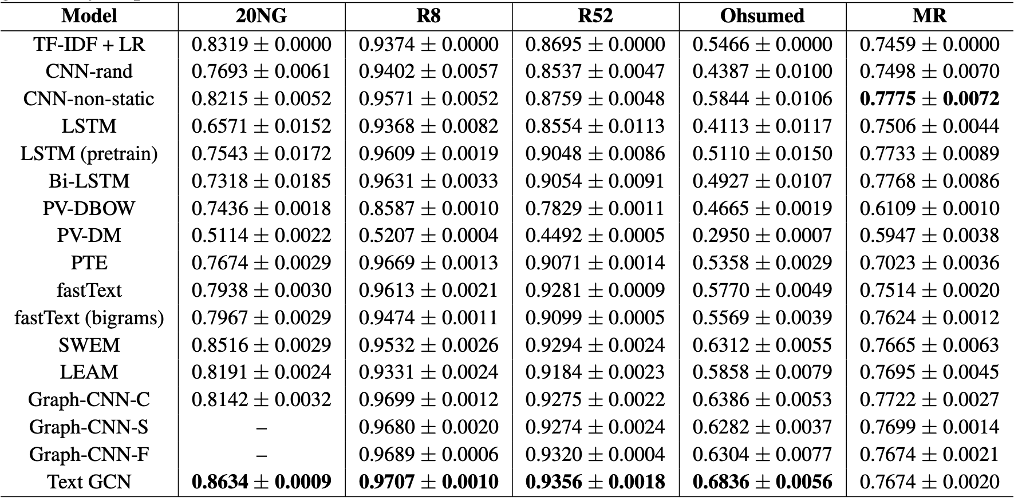

Slide 9
CAN WE IMPROVE THIS?
Try out different edge weights
Authors of the paper claim that the use of relation between words and documents improve the classification performance, we believe the edge weights might be calculated using in different ways instead of PMI and TF-IDF values without changing the underlying graph structure.

Slide 10
Effect of Number of Layers
A two-layer GCN can allow message passing among nodes that are at maximum two steps away. Thus although there is no direct document-document edges in the graph, the two-layer GCN allows the information exchange between pairs of documents.
A three-layer GCN can improve the performance if we can somehow incorporate 1st order weights between two documents.

Slide 11
Attention Mechanism
Future directions include improving the classification performance using attention mechanisms (Velickoviˇc et al. 2018) and developing unsupervised text GCN framework for representation learning on largescale unlabeled text data.

Slide 12
DATASETS - R8/R52
Two subsets of the Reuters 21578 dataset. R8 has 8 categories, and was split to 5,485 training and 2,189 test documents. R52 has 52 categories, and was split to 6,532 training and 2,568 test documents
Previous approaches worked well on this datasets, thus we are planning to verify if our approach works on this well known dataset.

Slide 13
DATASETS - Ohsumed/MR
The Ohsumed corpus2 is from the MEDLINE database, which is a bibliographic database of important medical literature maintained by the National Library of Medicine.
MR is a movie review dataset for binary sentiment classification, in which each review only contains one sentence (Pang and Lee 2005). The corpus has 5,331 positive and 5,331 negative reviews. We used the training/test split in (Tang, Qu, and Mei 2015)
We are planning to improve the scores on these datasets.

Slide 14
References
Graph Convolutional Networks for Text Classification: https://arxiv.org/abs/1809.05679
[Kipf and Welling 2017] Kipf, T. N., and Welling, M. 2017.Semi-supervised classification with graph convolutional networks. InICLR.[Le and Mikolov 201

